Slide 1
Visualizing Sentiment of COVID-related Tweets
Repo (GA only): git.generalassemb.ly/gwenrathgeber/project_5
linkedin.com/in/gwenrathgeber/
linkedin.com/in/eeujinlee/
Gwen Rathgeber and Eu Jin Lee DSI-12 The Matt
Instructor: Mahdi
Shadkam-Farrokhi

Slide 2
PROJECT SUMMARY
Goal: shed light on the United States’ reaction to the COVID-19 pandemic
Anyone can go on Twitter and see how the country is talking about the coronavirus pandemic, but we’d like to visualize that information in an interpretable way.
Limitations: time, scope, resources
We needed a relatively prepared dataset and pre-trained sentiment analysis model. Twitter API rate limiting makes a custom tweet search prohibitive, and labeling a training set to train our own sentiment classifier would likewise take too long for this project.
The actual classification process was extremely time-intensive, taking 1.5 days to classify our final set of ~65,000 tweets.
Product: a time-lapse visualization of tweet sentiment throughout the US
The final .gif is a 2 minute, 20 second summary of almost 5 months of the pandemic

Slide 3
WORKFLOW
Data
Visualization
“Hydrate” tweets: downloading from Twitter API
Create Visualization
Data
Analysis
Source Dataset: list of relevant Tweet IDs
Sentiment analysis with pre-trained model

Slide 4


DATA SOURCE
TWEET HYDRATION
~165,000 geotagged tweet IDs containing coronavirus-related words and hashtags
Downloaded and merged list of IDs from the IEEE Dataport
Used the twarc command-line tool to request all information about each tweet from the Twitter API

Slide 5

SENTIMENT ANALYSIS
We used the TextBlob library’s pre-trained Naive Bayes sentiment analyzer to classify tweets as positive or negative, giving a % probability of each.
Caveat: this model was trained on movie reviews, and is not ideal for our data.

Slide 6
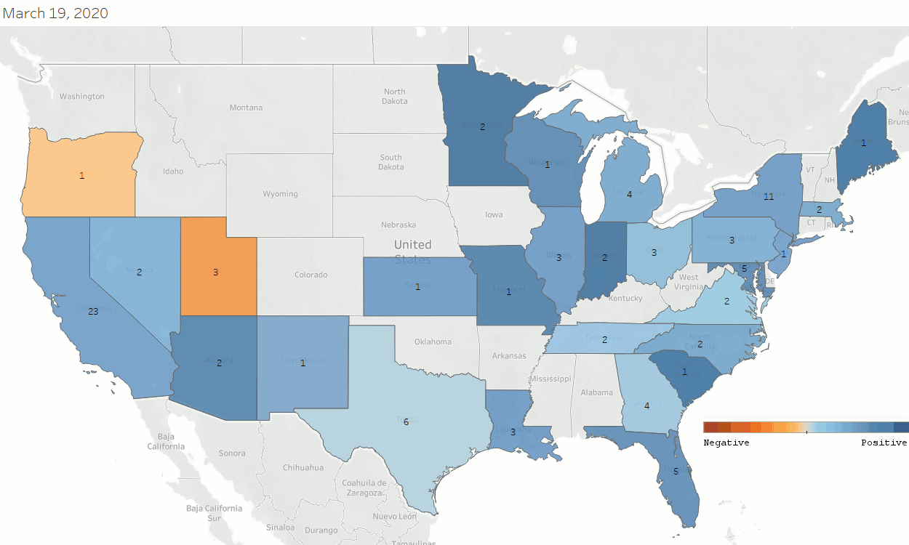
RESULTS
Scale:
Orange - most negative
Blue - most positive
Labels: Number of tweets considered in average
Transformations: Rolling average of the previous 4 days

Slide 7
FURTHER WORK
REFINE SENTIMENT ANALYSIS
FIND MORE
DATA
CREATE ADDITIONAL VISUALIZATIONS
Try a wider variety of pre-trained models, or use an API.
Twitter API limitations restricted our options, but getting a higher-tier API key or finding a larger dataset would improve the results.
Add annotations of major events, display time series, visualize more features such as retweets and likes.

Slide 8
REFERENCES
Data sourced from IEEE Data Point
Twitter API Wrapper
TweetAnalyzer class
Everything You Need to Know About Sentiment Analysis
Making a request to download csv

Slide 9

THANKS!
Do you have any questions?
Gwen Rathgeber & Eu Jin Lee
Repo (GA only): git.generalassemb.ly/gwenrathgeber/project_5
linkedin.com/in/gwenrathgeber/
linkedin.com/in/eeujinlee/

